Slide 1
Harrington Muhammad
SR. Network Engineer
Martin Marietta

Slide 2


What is a network engineer
Wait, what is an engineer?
What I do and what is a network?
Networking Components

Slide 3

Where Does internet data come from
Data centers
LAN
WLAN
WAN

Slide 4
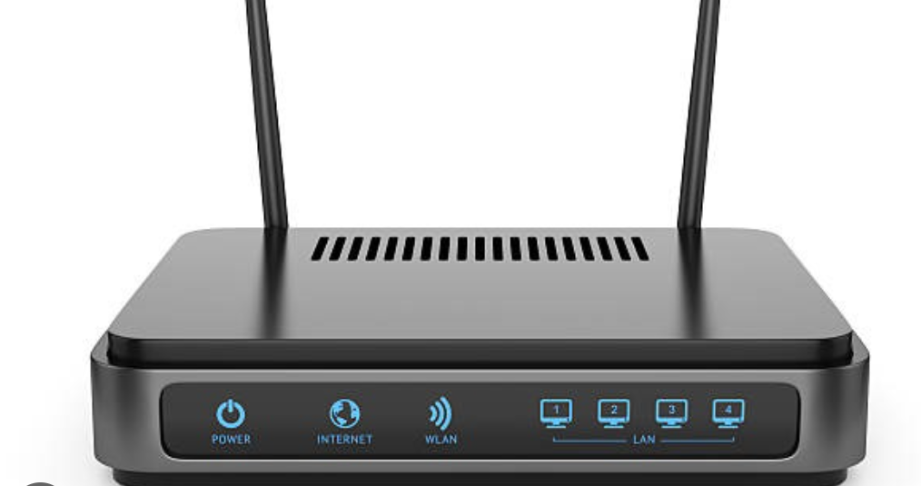
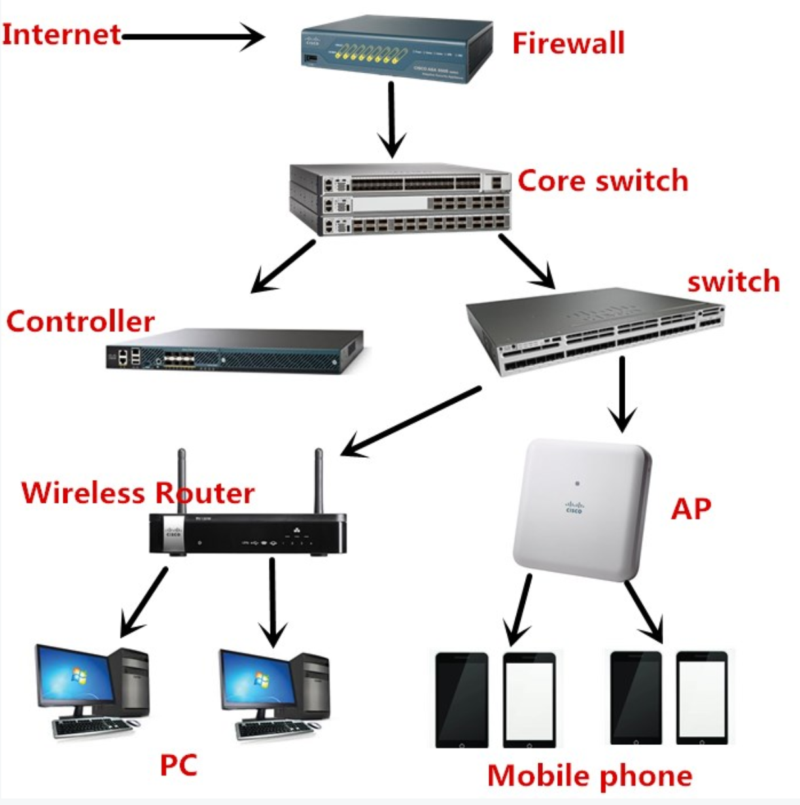
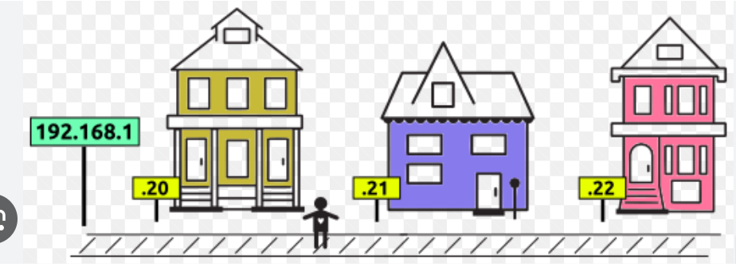
Networking devices Ip’s Macs
Ip’s and macs
Cabling

Slide 5
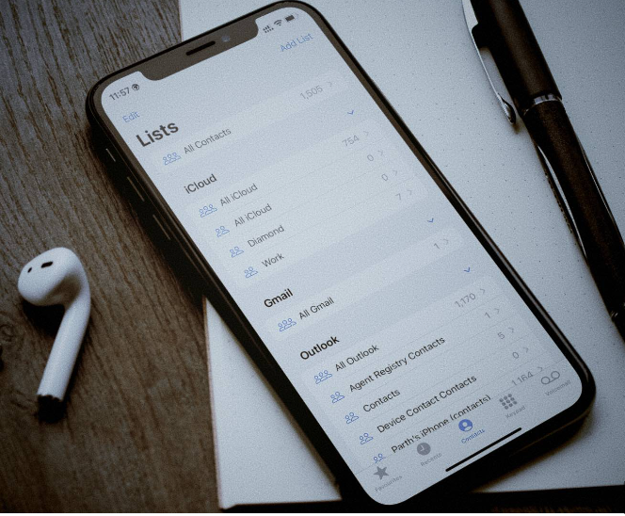





What is DNS

Slide 6

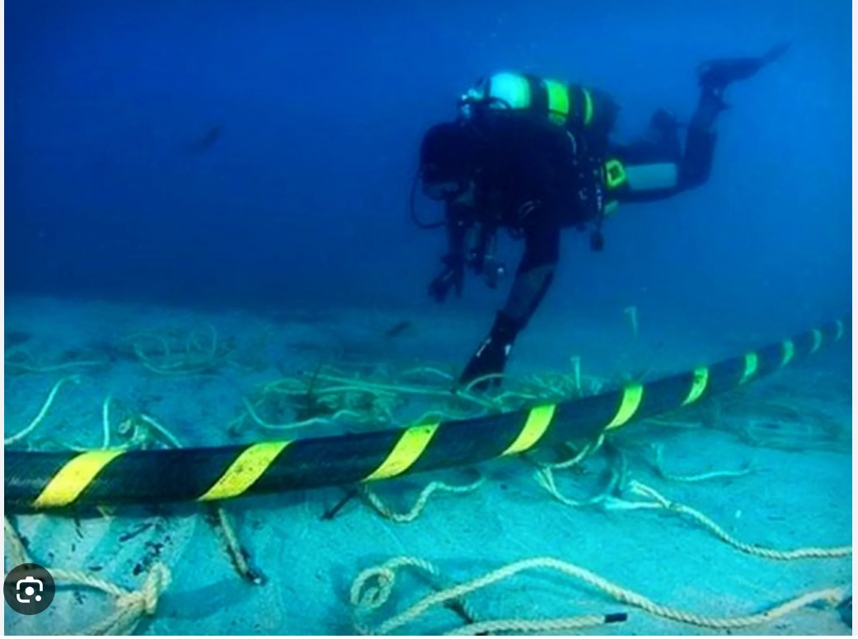
Can I be a Network Engineer?

