Slide 1
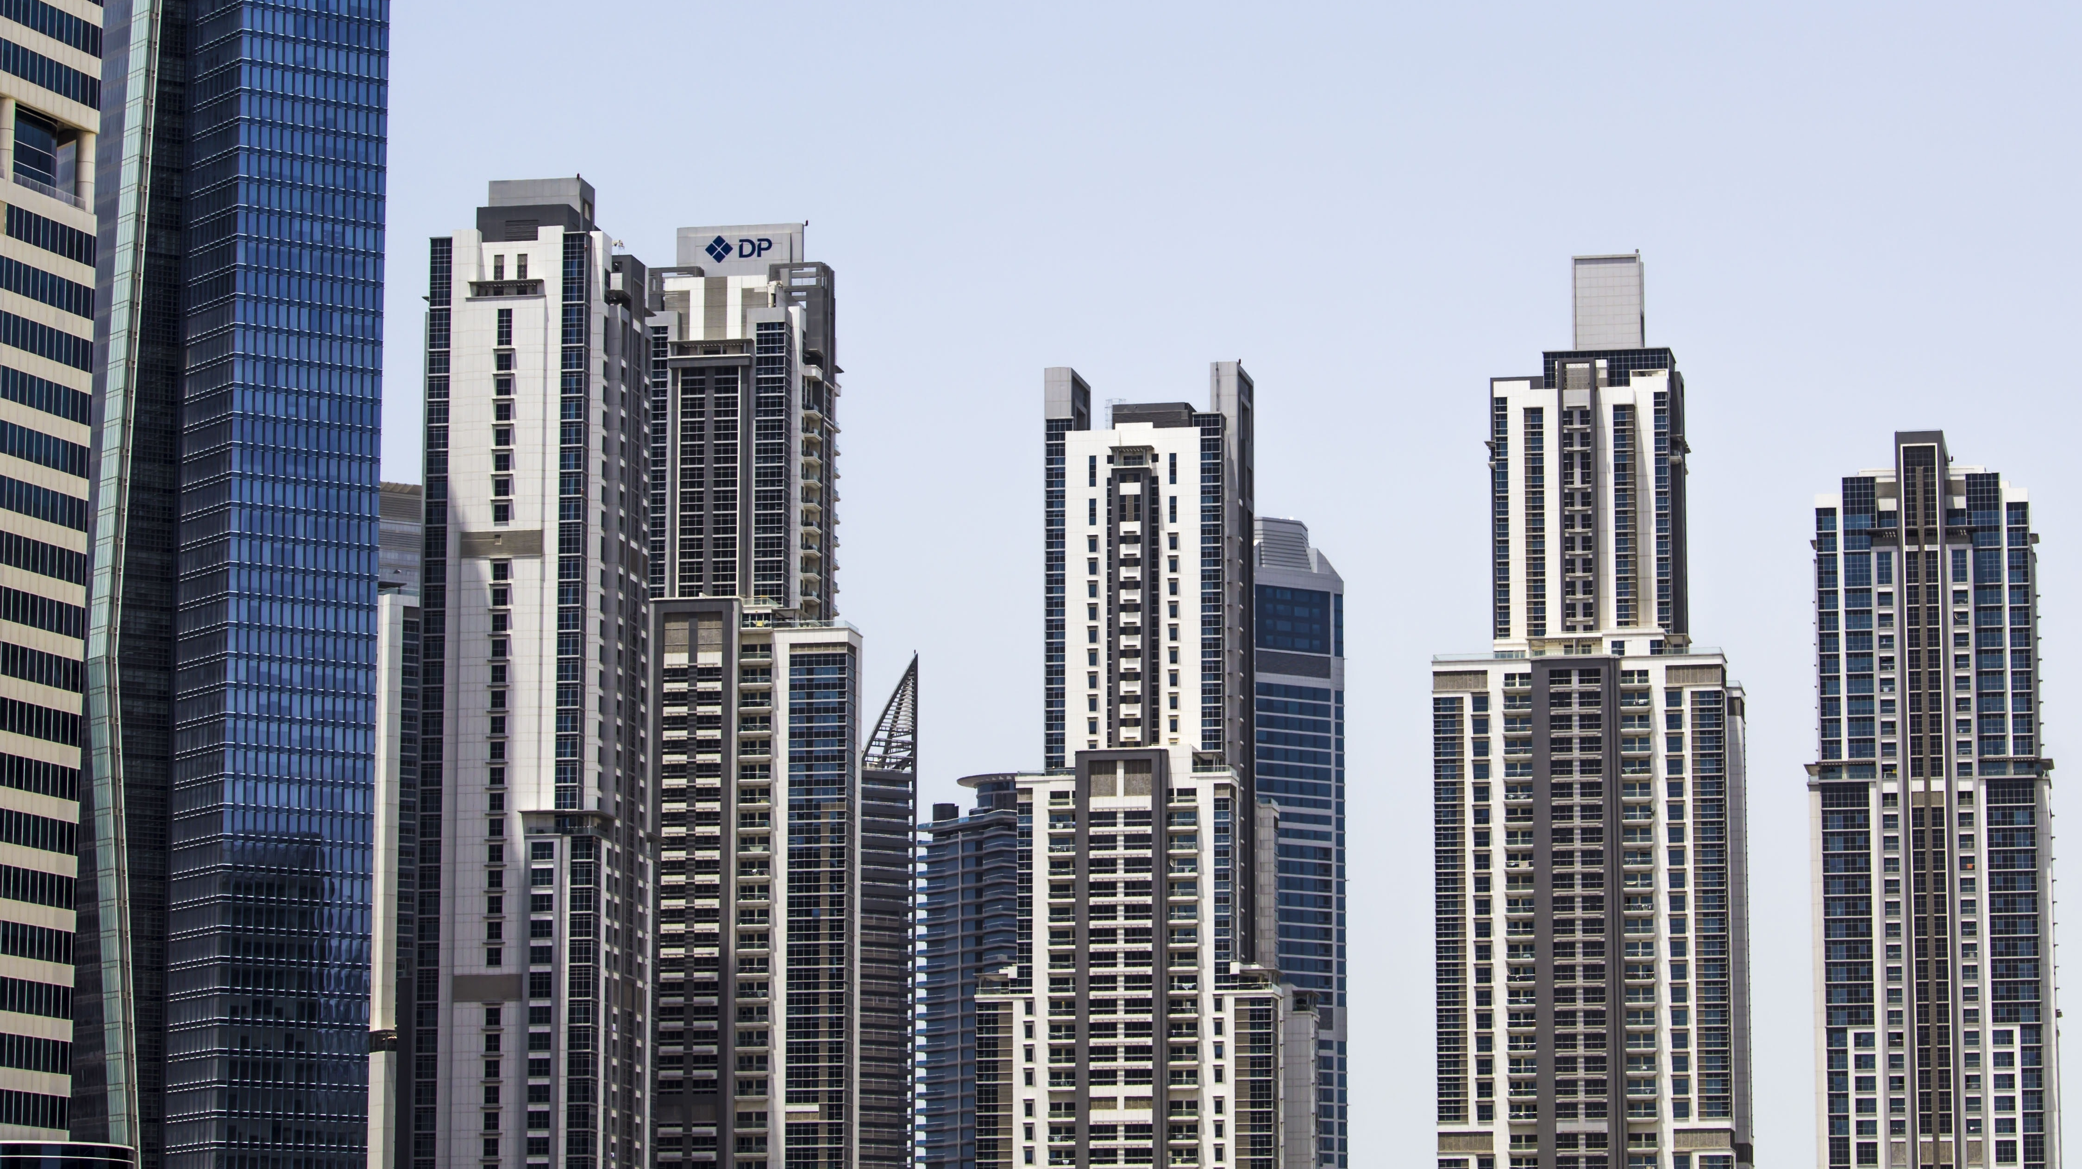
How we build a building
By: Brother Verron X

Slide 2
How to build a building
When we see these buildings, we are sometimes in awe of the size of the building and how it towers over everything. But we must understand the process for us to be able to build our own buildings and to have a city of our own. In this presentation, I am going to show you the steps in constructing a building.

Slide 3
The very start
Before any building is built, you have to clear the land to start the building process. In the picture shown, this is called an excavator. This piece of equipment is used to dig the rocks out and to pull the land to a smoother surface.
This Photo by Unknown Author is licensed under CC BY-SA

Slide 4
Smoothing the land completely to start building
In order to start building, you have to have a flat surface that is smooth and even. This piece of equipment is called a Bulldozer. This piece of equipment is used to smooth the land and make it a completely flat surface.
This Photo by Unknown Author is licensed under CC BY-SA-NC

Slide 5
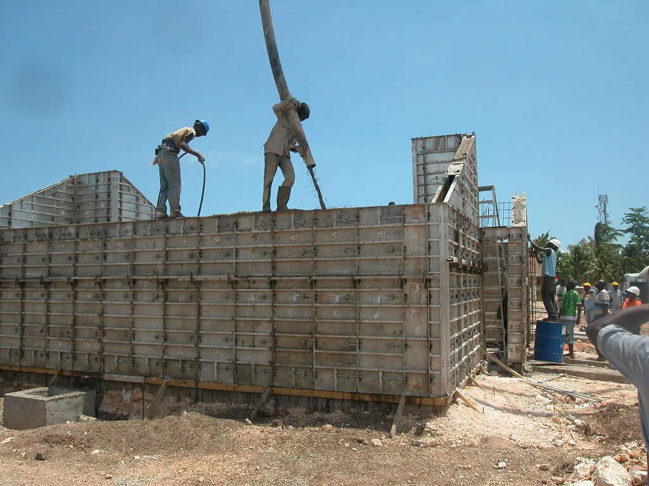
Concrete Forming
In this picture, the box that the men in the that’s standing on the structure are standing on what is called forms. The forms gives your foundation a shape. Forms can be placed in any shape to fit how you want your foundation to look.
This Photo by Unknown Author is licensed under CC BY

Slide 6
Rebar
In this picture, the pieces of iron that you see are called rebar. Rebar is inserted inside of the concrete forms before putting concrete inside of the forms. These pieces of rebar is what gives your foundation strength. Without these pieces of steel, the concrete can break very easily. This is a picture of a rebar mat from my project that I am the field engineer on.

Slide 7
Concrete
We are now at the concrete stage of our foundation. In this picture, this is the concrete slab that the building will sit on. The previous steps were necessary so that you can have a smooth and level surface to put your building to sit on.

Slide 8
The Building
Now that we went through the foundation part, we are now at the building. Instead of the rebar laying flat, this rebar is standing vertically. This gives your concrete building the strength that is needed to withstand hurricanes and other natural disasters.

Slide 9
The Finished Product
The building that you see is how a concrete building looks after you take the forms down. Notice how you cant see the rebar anymore. It is because you leave space between the forms and the rebar. This in the engineering world is called clearance.

Slide 10
A few pictures
This is a few pictures of the building process at my job.

Slide 11
Block layers

Slide 12
More block laying

Slide 13
Cinderblock Wall

Slide 14
Actual Concrete Pour
This Photo by Unknown Author is licensed under CC BY-NC

Slide 15
Partial Completion

Slide 16
Questions?

